Slide 1
Computer Reliability

Slide 2
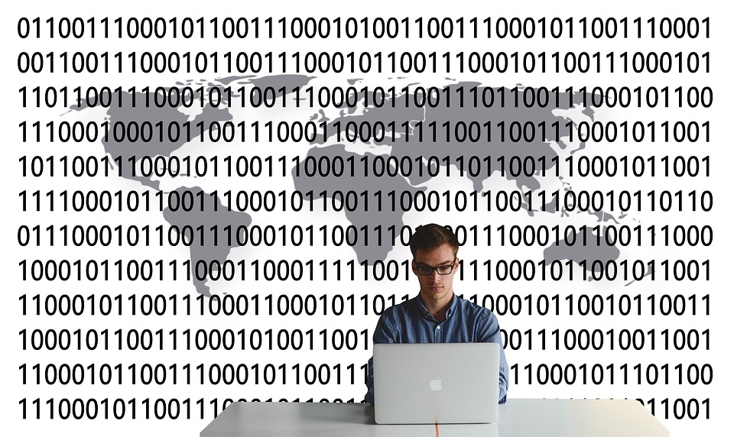
Topics covered
Introduction
Information technology disasters
Data errors
Billing errors
Warranties & liabilities

Slide 3
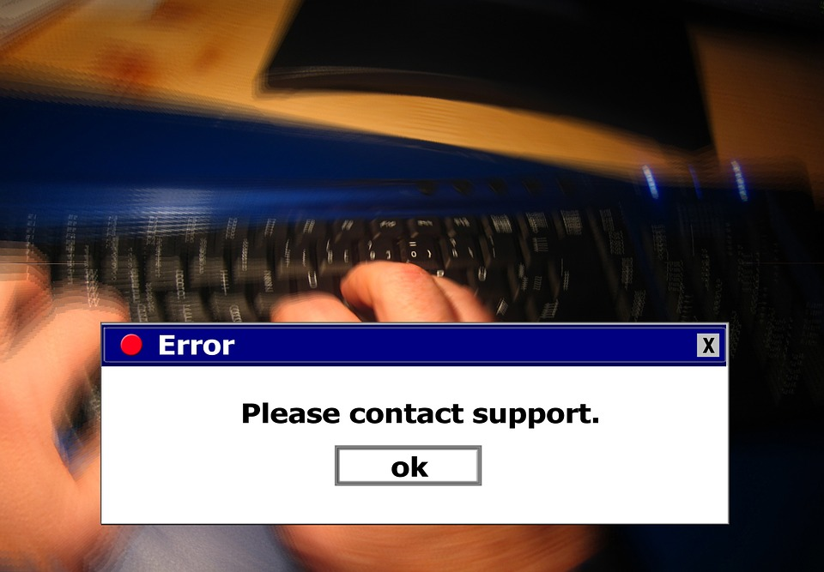
Introduction
Does the computer always give the correct answer?
Should we trust the output of computer programs?
The difference between a software professional and the general public is that a software professional is trained to not trust the output of a program until proven otherwise; whereas the general public believes the output of a computer.

Slide 4
Information Technology Disasters
In its short history, computer bugs have been responsible for great disasters.
The internet abounds with stories of great disasters caused by computers and software.
http://www.intertech.com/Blog/15-worst-computer-software-blunders/
http://www.infoworld.com/article/2609011/applications/the-worst-it-project-disasters-of-2013.html
http://www.parseerror.com/bugs/

Slide 5
Data Errors
It has been long known in Computer Science that garbage in means garbage out
United States Government Accountability Office has a white paper on “Assessing the Reliability of Computer-Processed Data
http://www.gao.gov/assets/80/77213.pdf
As we see from this paper the reliability and accuracy of data is fundamental for business and research decisions
Basic input checking is one key way to help verify integrity of data when it is entered into the system
Once inaccurate data is in the system it is difficult to detect and possibly impossible to fix

Slide 6

Billing Errors
It happens all the time
http://www.citynews.ca/2015/05/25/hydro-one-misled-customers-over-massive-billing-errors-ont-ombudsman/
Why does it happen?
Systems are incredibly complex
People make mistakes
How accurate are prices in a store?
Up to 10% in error
Canada has a Scanner Price Accuracy code
http://www.competitionbureau.gc.ca/eic/site/cb-bc.nsf/eng/03252.html

Slide 7

Warranties & Liabilities
You bought software. What do you expect in terms of warranties?
With software the warranties may not be what you expect
http://www.lexology.com/library/detail.aspx?g=884f40cf-4418-476a-98de-87e494debeb8
Often the warranty is listed as “as-is” meaning you get no warranty

Slide 8
Warranties & Liabilities
Freeware
Copyright issue allowing user to freely use the program
Usually same “as is” warranty
Shareware
Copyright issue allowing user to freely use the program for a period of time
Usually same “as is” warranty
Open source
Copyright issue allowing user to freely use and modify the program (normally cannot include it in products that are for sale)
Usually same “as is” warranty

Slide 9
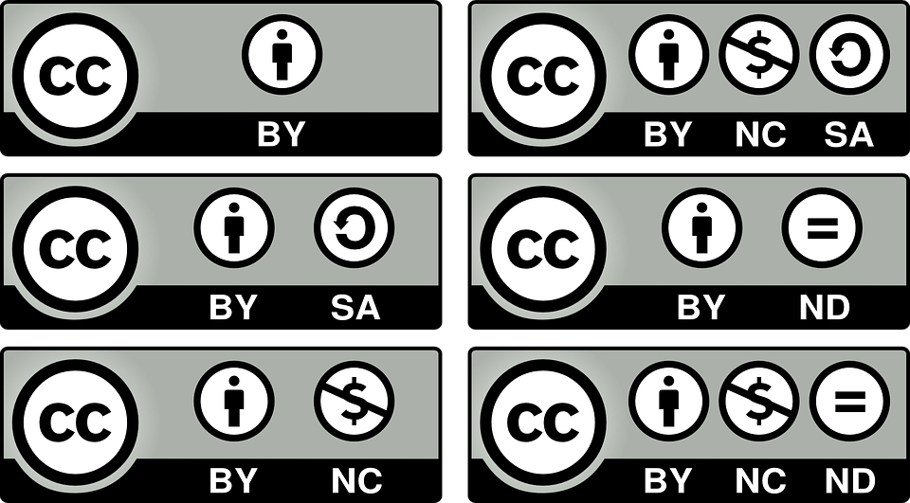
Warranties & Liabilities
What are you obligations when providing software be Freeware, Shareware or Open source
Normally specify “as is” warranty in copyright information
Investigate the licensing options to protect your intellectual property, and software ownership
https://en.wikipedia.org/wiki/Software_license

